Slide 1

Advanced Environmental Anomaly Detection: Integrating Graph Deep Networks with Geospatial Data Analysis
Name: SILAN HU 胡思藍
Mentor: Qinglin Zhao 趙慶林
Student Number: 2009853P-I011-0015
14/12-Progress Report

Slide 2

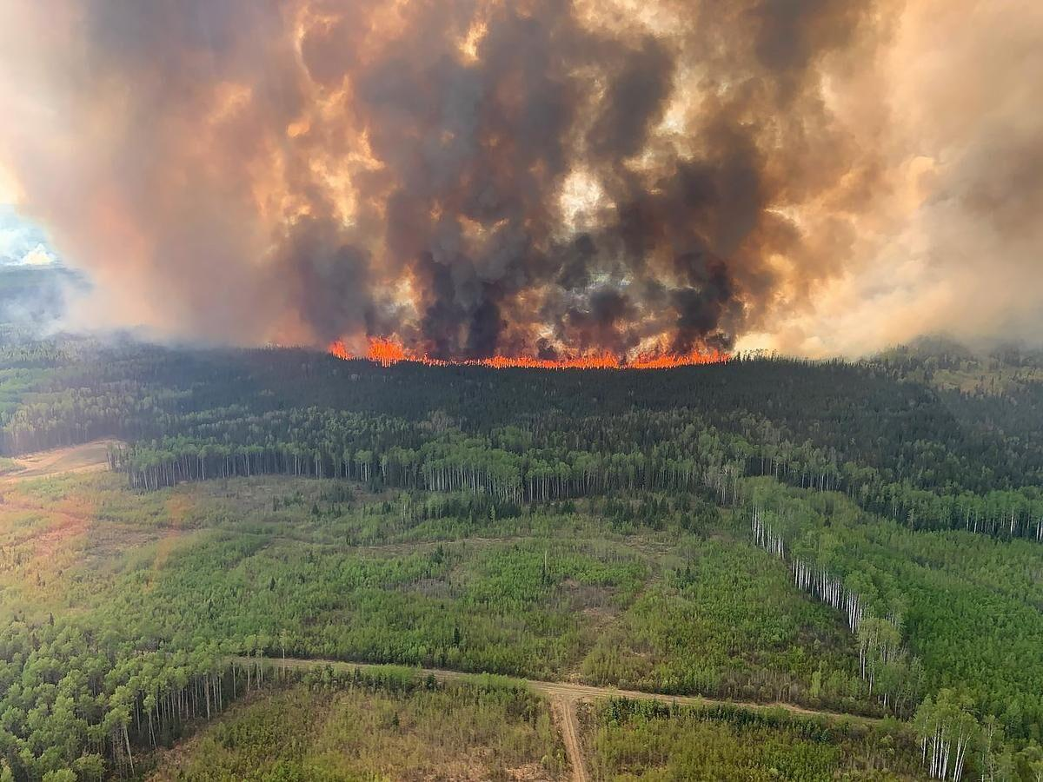
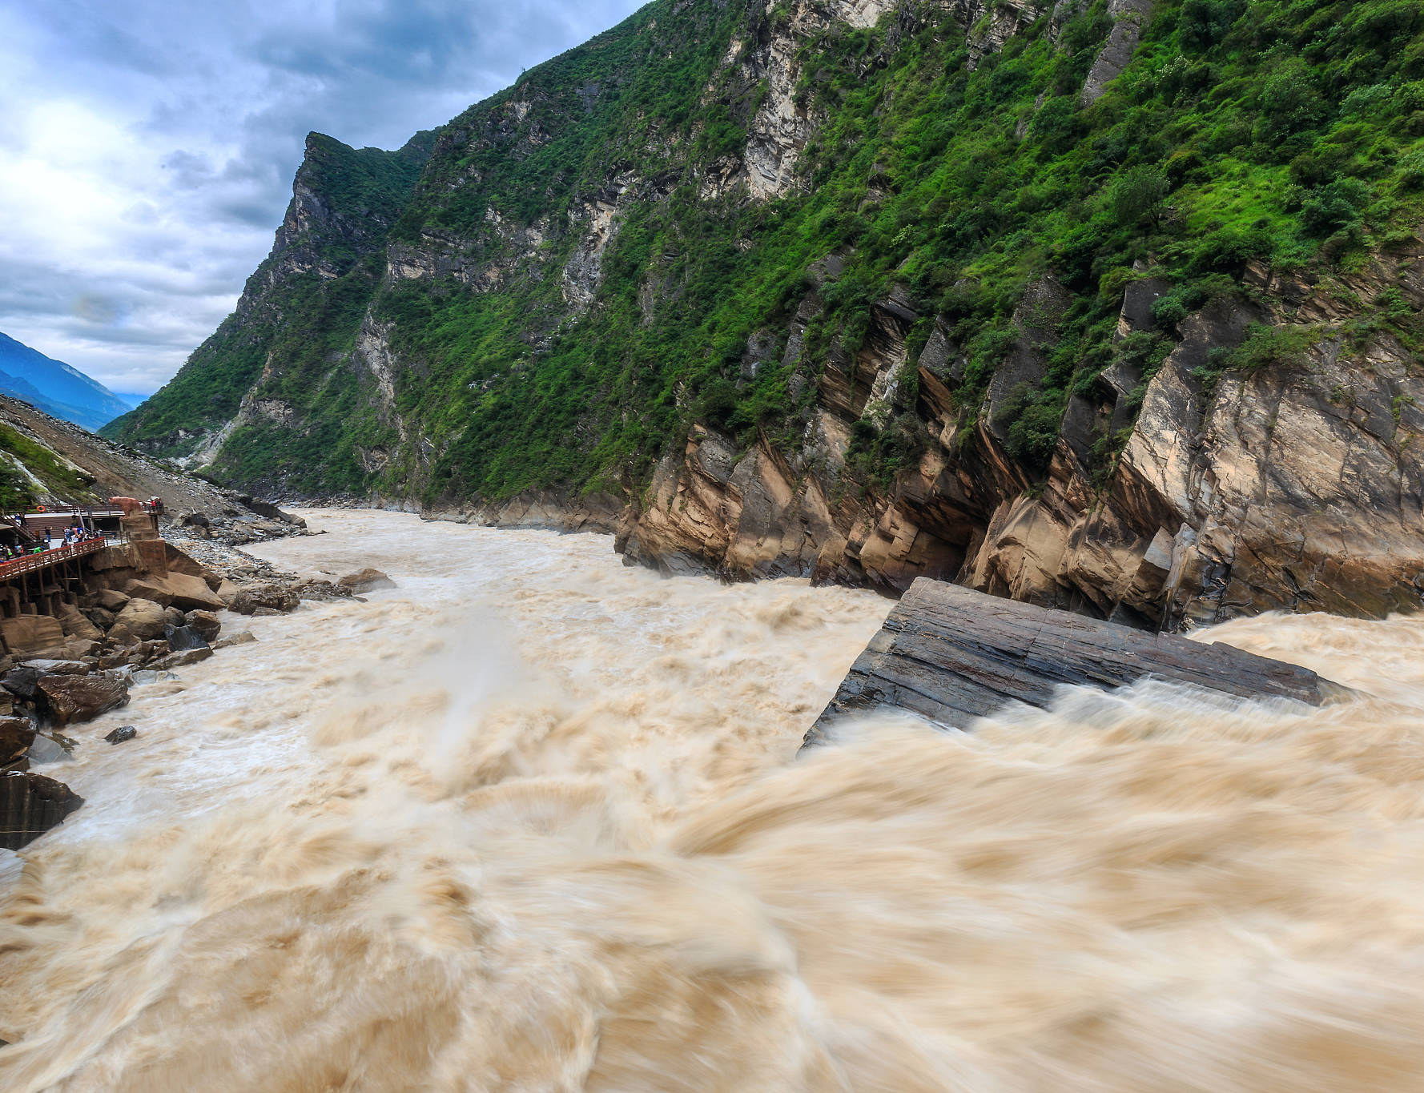
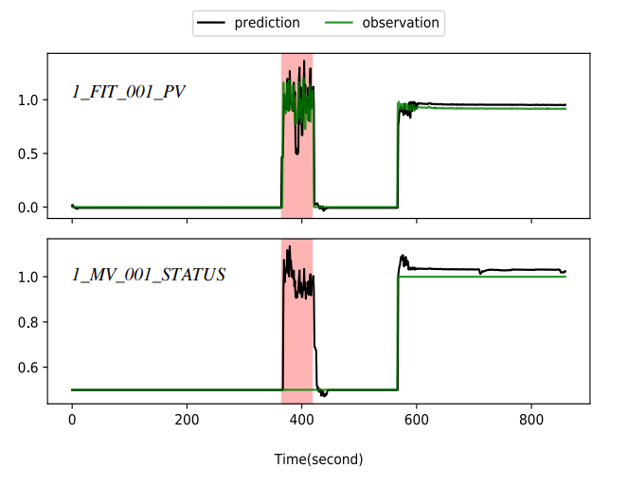
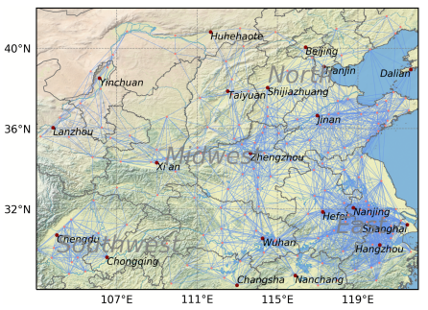
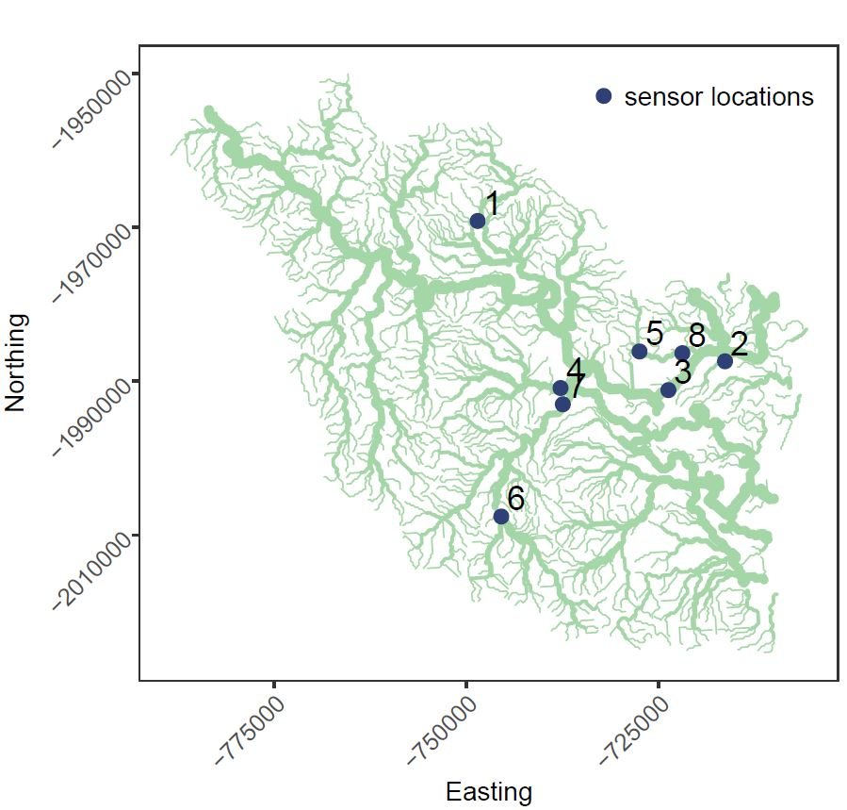
Macau University of Technology and Science 1. Background
1. Background: Environmental Anomaly-GNN(GDN)
Historically, predicting and detecting forest fires or flood warnings required specialized knowledge of forestry and environmental science. Traditional methods may be limited by the vast data involved and the speed at which conditions change.
Forest fires[1]
Flood warning[2]
In recent years, with the popularization of GNN technology, people have gradually realized that environmental monitoring often involves high-dimensional data from multiple sensors. GNNs can efficiently handle such multi-dimensional features, making them ideal for tasks such as disaster recognition and pollution tracking
Urban climate PM2.5[3]

Slide 3
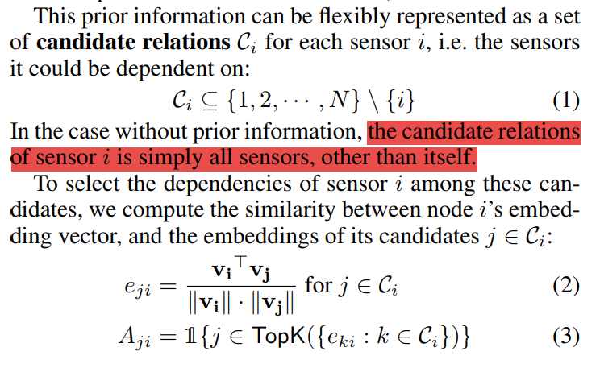
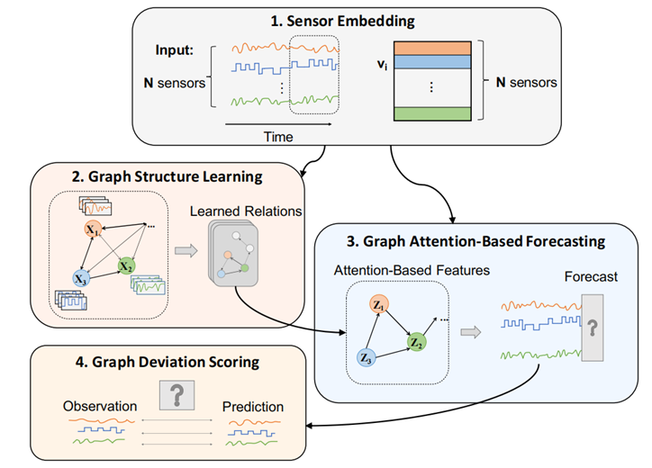
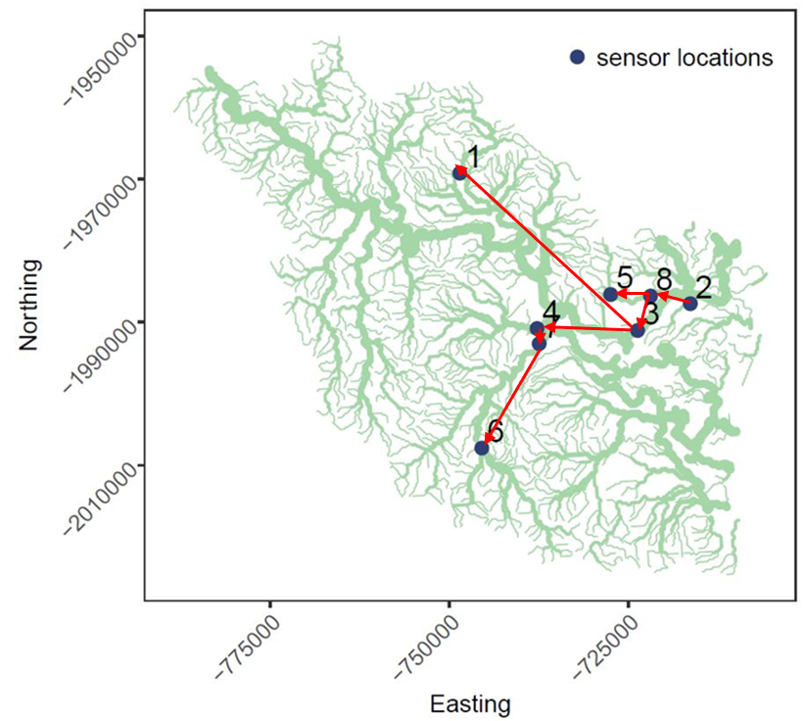
Macau University of Technology and Science 1. Background
2. Motivation:
The original method needs to associate all sensor nodes to solve the problem of water leakage in the water system, and it does not have generalizability.
Taking the Herbert[5] River system as an example, each monitoring node has a geographical connection as a strong association. We only need to consider neighbor nodes instead of all nodes. We can optimize GDN and propose GIGDN.
GDN for Water System[4]

Slide 4
Macau University of Technology and Science
3. Objectives
This research project aims to leverage the strengths of GNNs, specifically Graph Deviation Networks (GDN), to develop a more effective and efficient method for environmental anomaly detection (with Geographical coordinate labeling). Our objectives are:
To adapt and extend GDN for the nuanced needs of environmental monitoring, incorporating geospatial information directly into the anomaly detection process.
To conduct extensive testing and validation of our model using both simulated and real-world datasets, ensuring its applicability and robustness in various environmental contexts.
To compare the performance of our enhanced GDN model (GIGDN) against traditional and current state-of-the-art anomaly detection methods, demonstrating its improved accuracy and interpretability.
(Additional) The proposed GIGDN will be used to generate quick-to-use software to help other researchers gain assistance in GNN processing of environmental anomaly data.

Slide 5
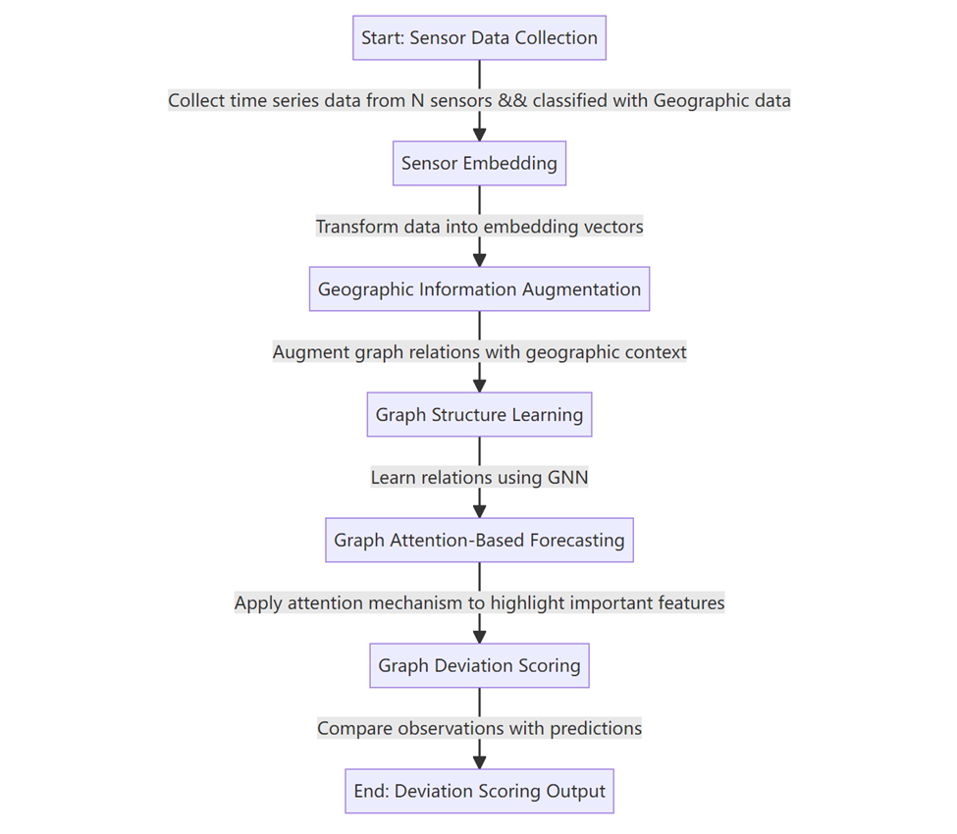
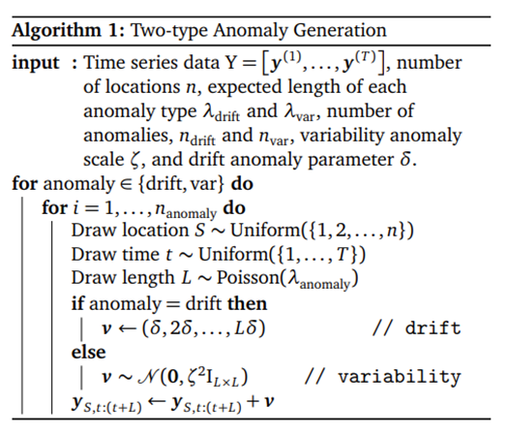
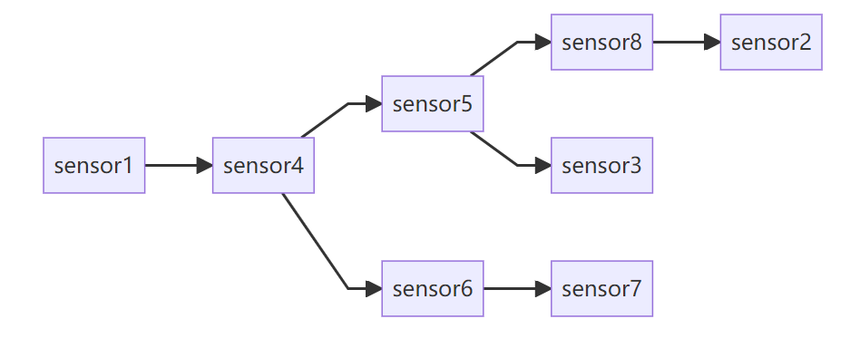

Macau University of Technology and Science
4. Methodology:
Simulated Algorithm[5]
Two types of anomalies,
1）High-Variability: These anomalies are characterized by periods of unusually high or low variability in the data obtained from in-situ sensors.
2）Drift: This type of anomaly refers to sensor drift, this could be due to issues like sensor miscalibration over time.
Propagation factor p

Slide 6
Macau University of technology and science
Current Work &&
research plan
Progress | Date
Thesis proposal writing and defense | Otc., 2023 – Nov.,2023
Experimental environment construction | Dec., 2023
Experiment and result analysis | Jan., 2024 – Mar., 2024
Thesis writing and defense | Apr, 2024

Slide 7
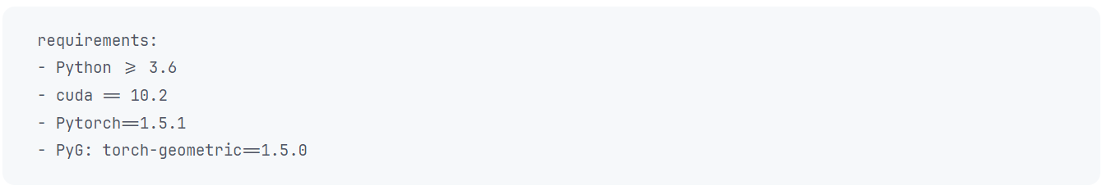
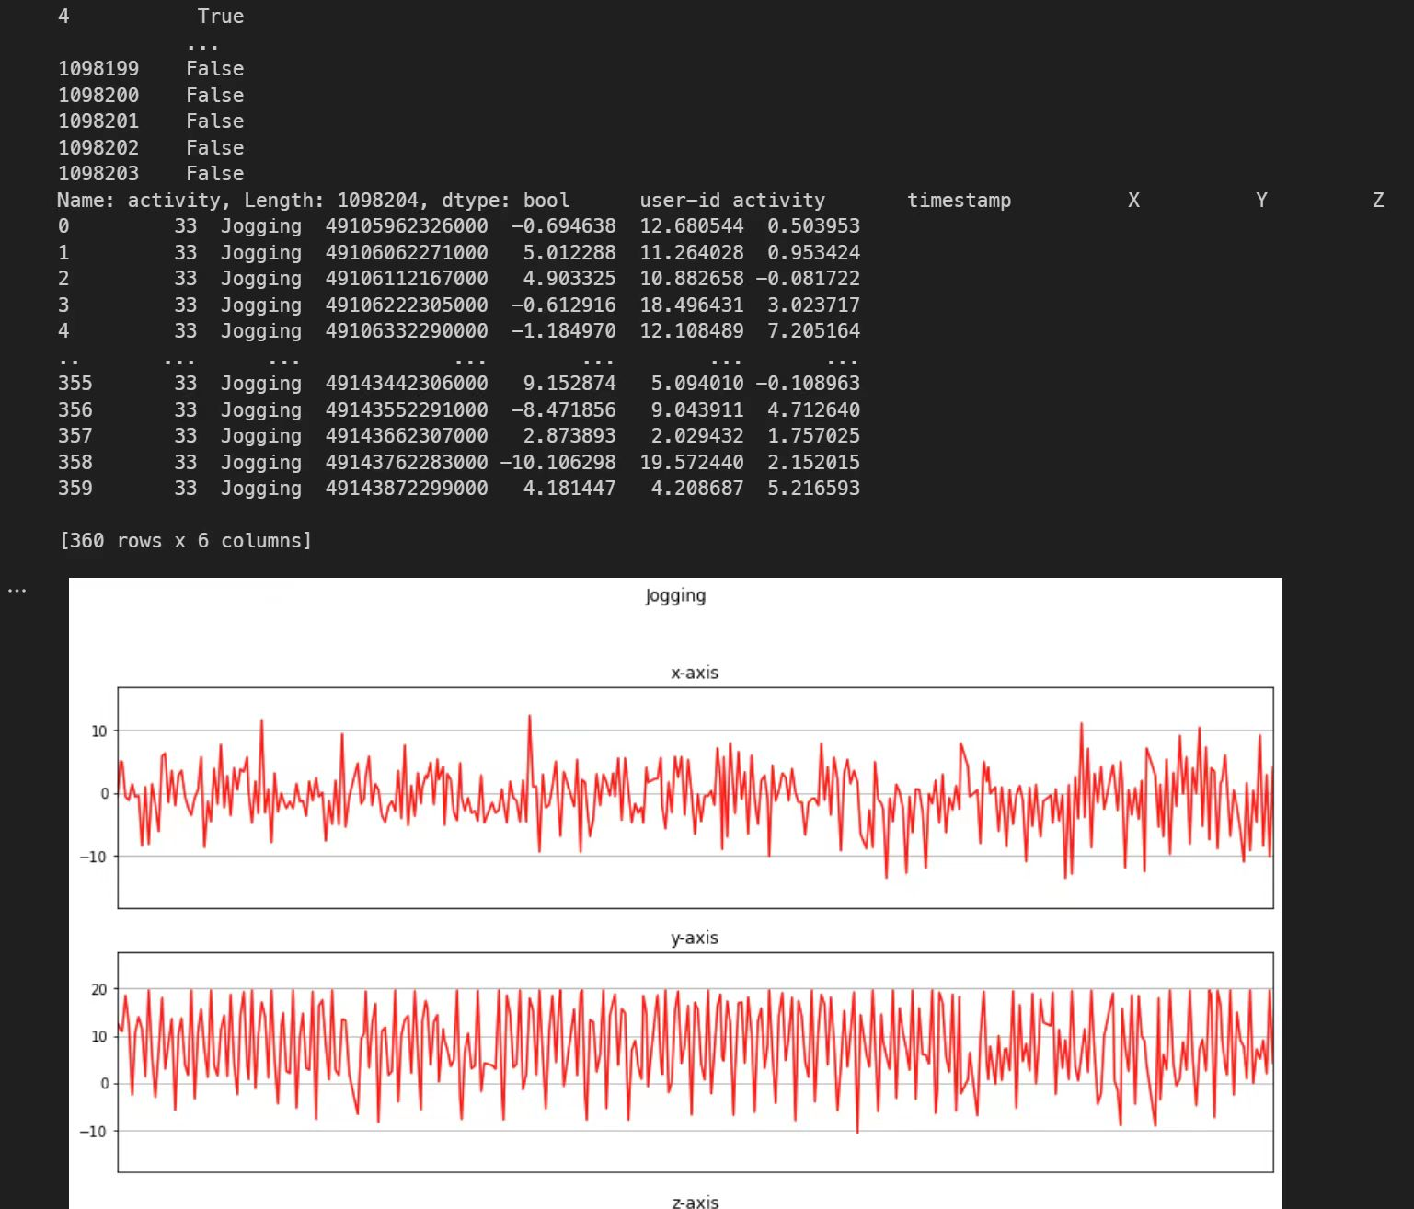
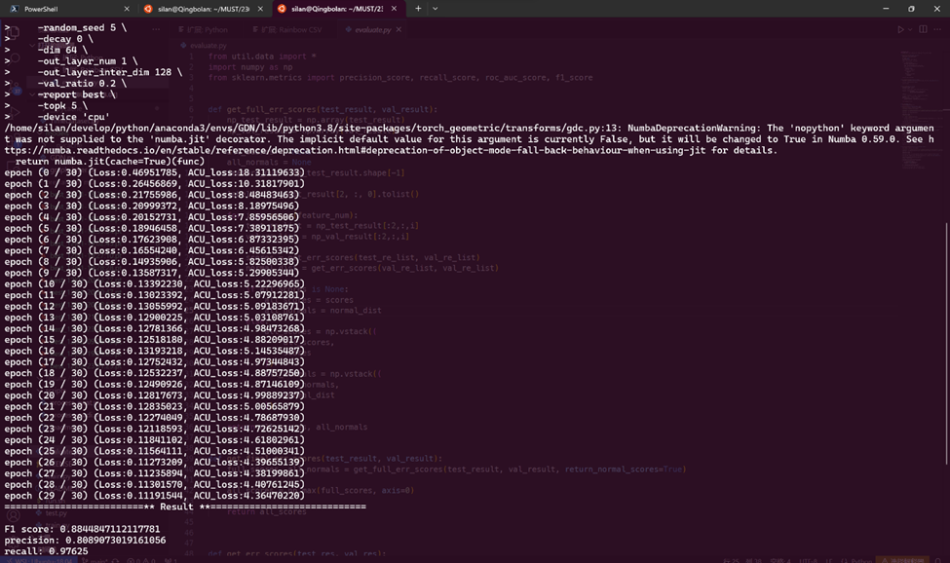
Macau University of Technology and Science
5.1 Reproduction of experimental results and code reconstruction:
Analysis of SWaT Data Set provided by original GDN model experience

Slide 8
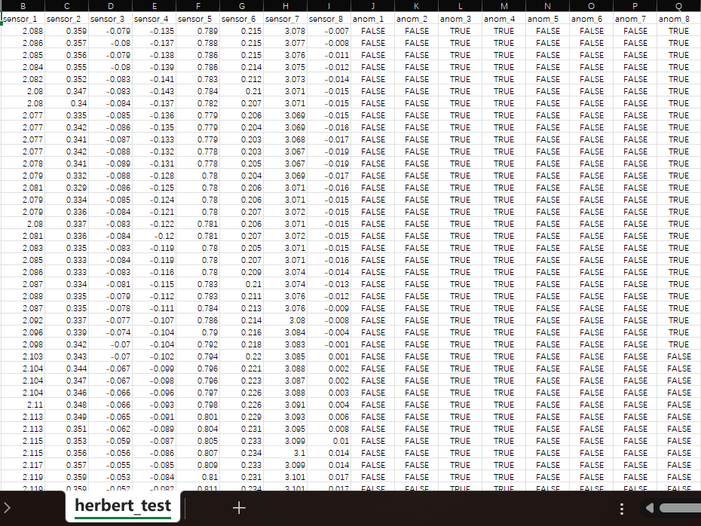
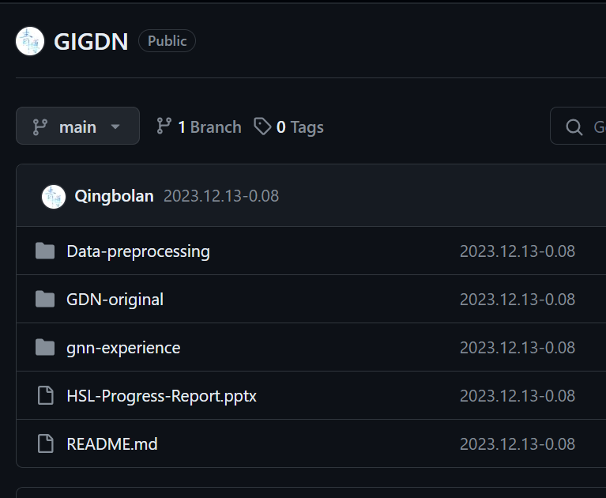
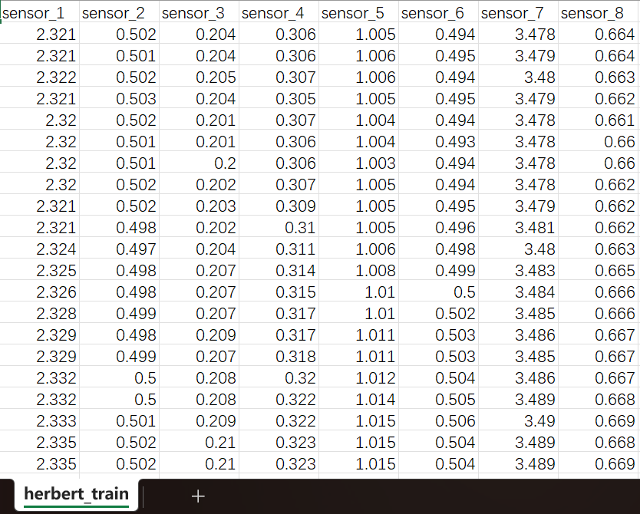
Macau University of Technology and Science
5.2 Data preprocessing:
【GIGDN】My own github repository[6]
【Data Set】Herbert

Slide 9
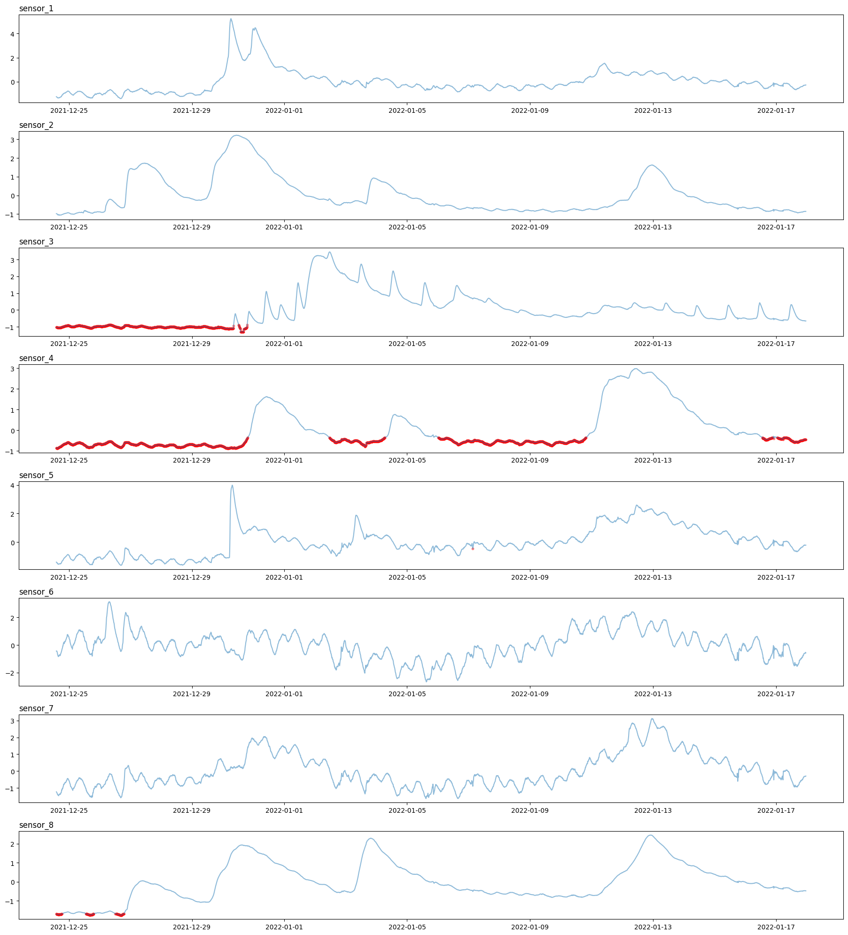

Macau University of Technology and Science
5.2 Data preprocessing:

Slide 10
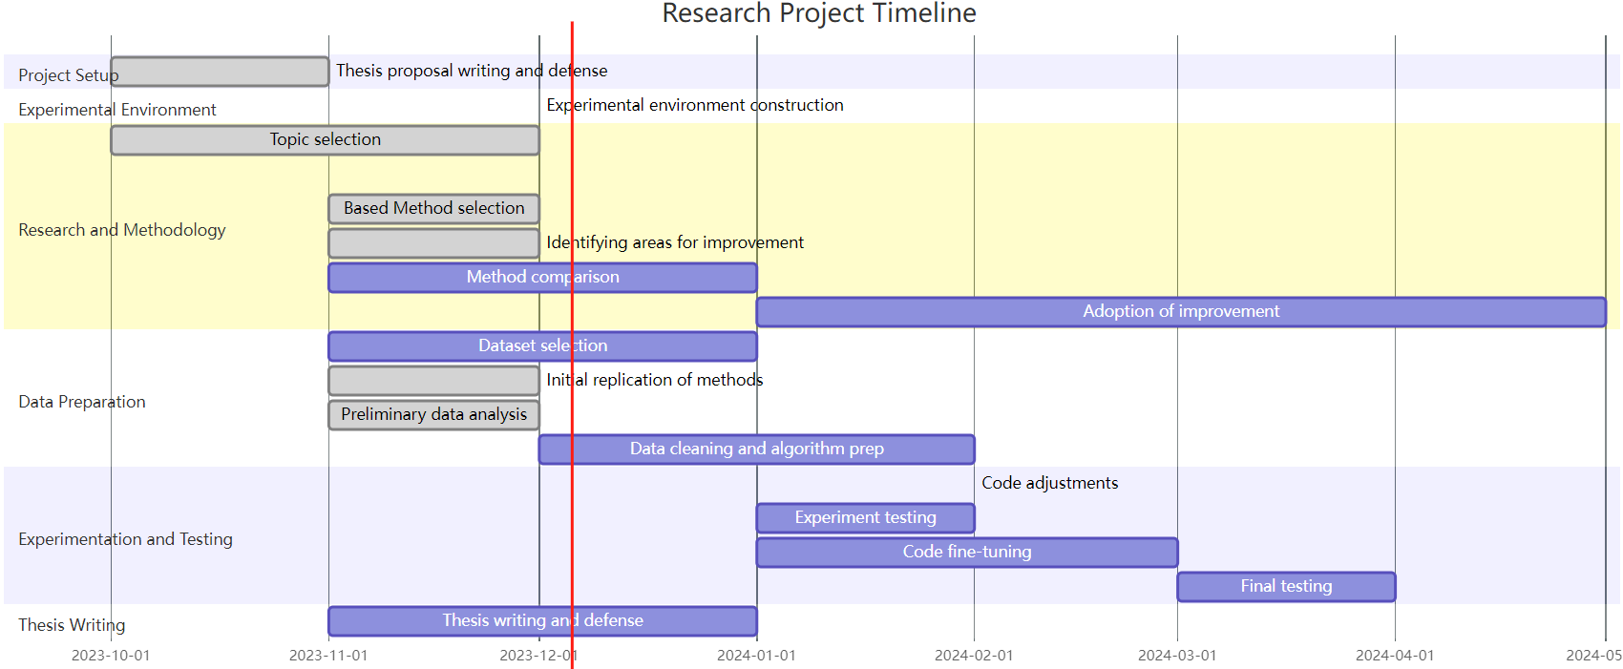
Macau University of Technology and Science
1. Project Setup
•Thesis Proposal Writing and Defense (Oct 2023 - Nov 2023): This phase involves the preparation and defense of the thesis proposal. It's marked as completed, indicating that the foundational concept and plan for the research have been established and approved.
2. Experimental Environment
•Experimental Environment Construction (Dec 2023): This stage is focused on setting up the necessary environment for conducting experiments, such as software installation, hardware setup, or configuring simulation environments.
3. Research and Methodology
•Topic Selection (Oct 2023 - Dec 2023): The process of choosing an appropriate research topic. It has been completed, signifying the project's focus has been determined.
•Literature Review and Research (Oct 2023 - Jan 2024): In-depth study and analysis of existing literature related to the topic, extending until January 2024.
•Based Method Selection (Nov 2023 - Dec 2023): Selecting a base method or model for the research. This task is already completed.
•Identifying Areas for Improvement (Nov 2023 - Dec 2023): This task involves analyzing the selected method to identify potential areas for improvement.
•Method Comparison (Nov 2023 - Jan 2024): Comparing different methods or models to select the most suitable one for the research.
•Adoption of Improvement (May 2024): Implementing the identified improvements in the method or model.
4. Data Preparation
•Dataset Selection (Nov 2023 - Jan 2024): Choosing appropriate datasets for the experiments.
•Initial Replication of Methods (Nov 2023 - Dec 2023): Initial attempts to replicate the selected methods, already completed.
•Preliminary Data Analysis (Nov 2023 - Dec 2023): Conducting an initial analysis of the data.
•Data Cleaning and Algorithm Prep (Dec 2023 - Feb 2024): Preparing the data for experimentation, which includes cleaning and algorithm setup.
5. Experimentation and Testing
•Code Adjustments (Feb 2024): Making necessary adjustments to the code.
•Experiment Testing (Jan 2024 - Feb 2024): Testing the experiments to evaluate their performance.
•Code Fine-Tuning (Jan 2024 - Mar 2024): Further refining the code based on testing outcomes.
•Final Testing (Mar 2024 - Apr 2024): Conducting final rounds of testing to ensure robustness and accuracy.
6. Thesis Writing
•Thesis Writing and Defense (Nov 2023 - Jan 2024): Writing the thesis based on the research findings and preparing for the final defense.

Slide 11
Macau University of Technology and Science
7. Reference
[1] Salehi, M., & Rashidi, L. (2018). A Survey on Anomaly detection in Evolving Data: [with Application to Forest Fire Risk Prediction]. ACM SIGKDD Explorations Newsletter, 20(1), 13-23.
[2] Stoyanova, J. S., & Georgiev, C. G. (2013). SVAT modelling in support to flood risk assessment in Bulgaria. Atmospheric research, 123, 384-399.
[3] Wang, S., Li, Y., Zhang, J., Meng, Q., Meng, L., & Gao, F. (2020, November). PM2. 5-GNN: A domain knowledge enhanced graph neural network for PM2. 5 forecasting. In Proceedings of the 28th international conference on advances in geographic information systems (pp. 163-166).
[4] Deng, A., & Hooi, B. (2021, May). Graph neural network-based anomaly detection in multivariate time series. In Proceedings of the AAAI conference on artificial intelligence (Vol. 35, No. 5, pp. 4027-4035).
[5] Buchhorn, Katie, et al. "Graph Neural Network-Based Anomaly Detection for River Network Systems“ arXiv preprint arXiv:2304.09367 (2023).
[6] https://github.com/Qingbolan/GIGDN

